Slide 1


AI TECH IN SPORTS

Slide 2
INTRODUCTION
Artificial Intelligence, is a branch of computer science which covers a variety of what are called “smart” technologies. AI takes information and responds to it. AI can take mass amount of data and can analyse it. At the highest level, we can see self-driving cars and drones, but in a day-to-day practical way, it boils down to how computers can accumulate data and then apply it- learning, growing and making decisions on it.
AI can perform automated tasks, help do things better and more quickly, assist with better decisions and ultimately, automate decision-making processes that can be done without people.
AI technologies mimic humans ability to Sense, Think and Act.

Slide 3
AI ADVANTAGES IN SPORTS
COACHING & TRAINING
HEALTH CARE & SAFETY
AI provide us a way on how to perform tasks.
AI tells us what precautions to follow and in what manner.
WHAT AI CAN PROVIDE
TRAINING & ANALYSIS
FAN ENGAGEMENT
AI give us a better and easier way in traning.
Despite in performance, AI also encourage the engagement of fans in sports.

Slide 4
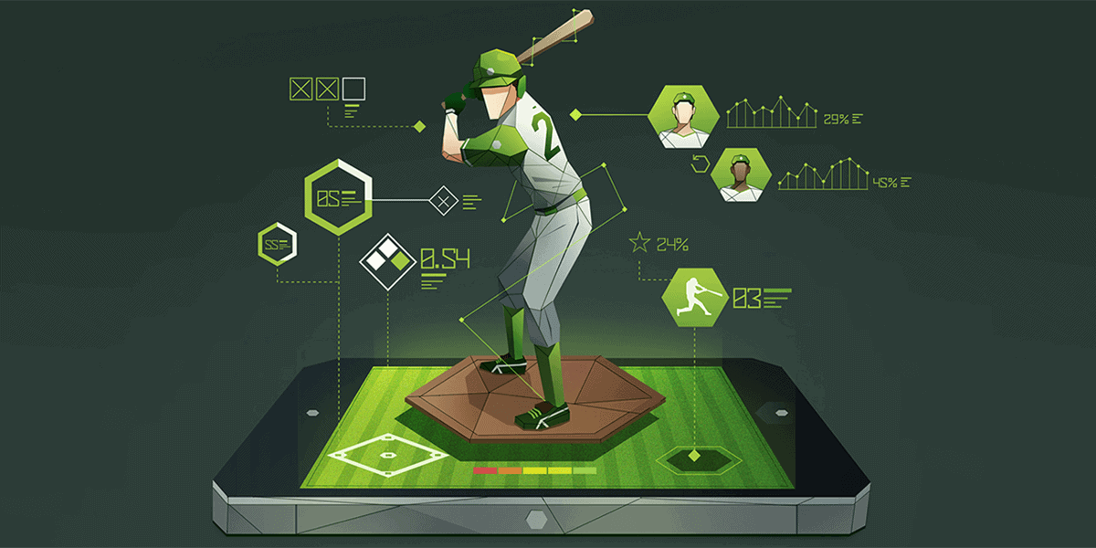
COACHING & TRAINING
How an athlete trains, analysis of their game performance and how a coach prepares their teams to tackle an opposition is rapidly changing with the advancement of technology.
AI applications containing data on a large number of training and game performances, coupled with knowledge from several expert sports scientists and coaches will act as a definitive central source of current knowledge.
AI provide us the correct, easier way of performing task. A coach can easily detect wrong performance of player with the help of AI and can train them in a better way.

Slide 5
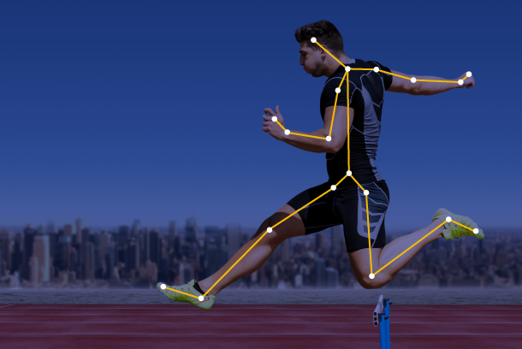
HEALTH CARE & SAFETY
Artificial intelligence is applied in sports through predictive analysis to improve performance and health. Athletes can prevent major injuries thanks to the development of wearables that collect data on degrees of strain and wear. This technology also allows for faster response times in emergency situations and better data-driven decisions about how best to reduce risk.
By comprehending many metrics, including spin, speed, serve placement, and even player posture and motion, artificial sports intelligence can enhance sporting performance further.

Slide 6
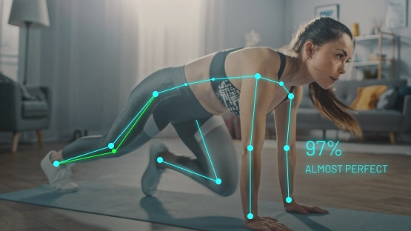
TRAINING & ANALYSIS
With the help of wearable technology, the athletes can gather information on strain and tear levels and can further avoid serious injuries. An AI diet plan uses machine learning to customize different meal plans for different players based on their needs and schedule.
The use of AI in sports training is boosting the effectiveness of each activity for each individual by creating customised training plans for players and providing real-time feedback. Teams can use AI to develop strategies and tactics and play to their strengths.

Slide 7
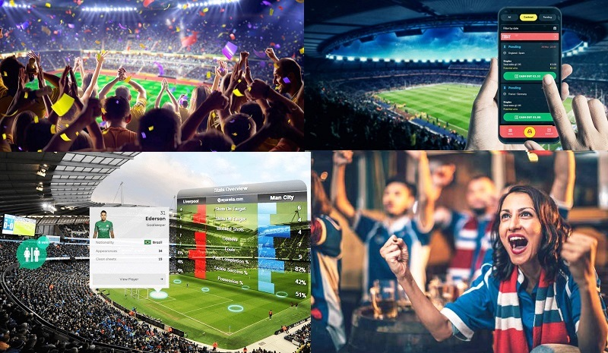
FAN ENGAGEMENT
With the help of AI now fans can easily get to know about their favorite player. AI provide fans access to their favorite teams through app. They can track their tickets, receive alerts when new stuff is available, find check-in locations on gameday, and keep an eye on the schedule. The predictive analysis can access player growth and develop potential and interest of fans towards the game. AI can suggest fans what they want by going through their previous data.
AI made people’s life easy by saving their time and suggesting them what they want to see.

Slide 8
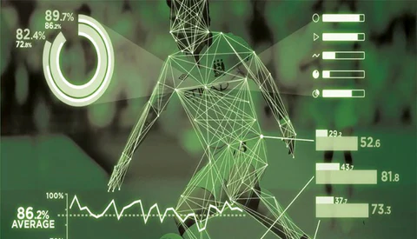
AI WORKOUTS & PLAYER ANALYSIS
AI systems facilitate the control of various aspects of sports during training. For example, a combination of cameras and sensors in tennis games helps measuring speed, spin and placement on a serve. This can then have a direct impact on the strategic decisions taken by coaches and training staff.
Perhaps one of the most relevant applications of AI today. It’s in fact particularly valuable for sports like football, where multiple players are involved and huge investments are made. In this context, AI provides help in selecting players from a much more objective, data-based approach that is based on predictions of potential, overpassing what a human scout could do.

Slide 9
FUTURE SCOPE OF AI IN SPORTS
AI is changing sports in fundamental ways, from player performance metrics to sport consumer behavior analysis. The use of AI provides coaches and players with a significant advantage over those who rely solely on human expertise.AI can provide sport business executives with richer, real-time insights into the preferences, needs, and behaviors of sport consumers, leading to the creation of tailored and personalized sport content.While AI is unlikely to completely replace coaches and human specialists, it can be used as a tool to enhance their capabilities and decision-making processes.The implementation of AI in sports raises important ethical and privacy considerations, particularly around the ownership and confidentiality of league, team, and player-level data.Ownership and confidentiality of sports data will become increasingly contentious legal issues, leading to potential conflicts in locker rooms and on the playing field. It is important for individuals and organizations to maintain control over the use of their data.

Slide 10
ETHICAL & SOCIAL IMPLICATIONS
Fairness is a key ethical concern when it comes to AI in sports. The use of AI technologies can potentially favour certain athletes over others, giving them an
unfair advantage.AI can be used to identify the flaws of rival athletes and devise winning strategies, further contributing to the unfairness of the competition.
The use of AI to decide who is eligible to compete can lead to arbitrary elimination of athletes from contests, creating further ethical concerns.As AI continues to develop and become more prominent in the sports industry, it is important to address these legal and ethical issues to ensure a fair and equitable playing field for all athletes.

Slide 11
ROLE OF AI IN ENTERTAINMENT & MEDIA
Artificial intelligence is increasingly being used in sports media, extending beyond traditional television broadcasting to social media platforms such as Instagram, Facebook, Twitter, and Reddit.Social media platforms are also being used to broadcast streaming highlights after games, providing viewers with an opportunity to catch up on crucial moments. AMAs (Ask Me Anything) and polls hosted on social media after games present an opportunity for interaction between fans and sports clubs. With the advancement of artificial intelligence and virtual reality, sports media technologies are expected to further evolve, providing even more immersive and engaging experiences for viewers.

Slide 12
CONCLUSION
AI provides countless options, and newer systems are constantly being developed, which can increase the variety of data processing options. With the advancement of artificial intelligence (AI), humans are now better able to predict the future than in the past. Because of the ability to digest information more quickly, we may now take on challenging tasks and study data from a variety of perspectives.
AI technologies are evolving fast and growing increasingly critical for a sporting organisation’s ability to win games; improve coaches and players; manage their operations and grow. However, unless sporting organisations plan, deploy, and govern it correctly, new AI technology will provide meagre benefits at best or, at worst, result in unexpected and undesired outcomes. AI can be helpful for us but in a completely unexpected way because even we cannot pretend what future AI will show us.

Slide 13
THANKYOU

